Slide 1


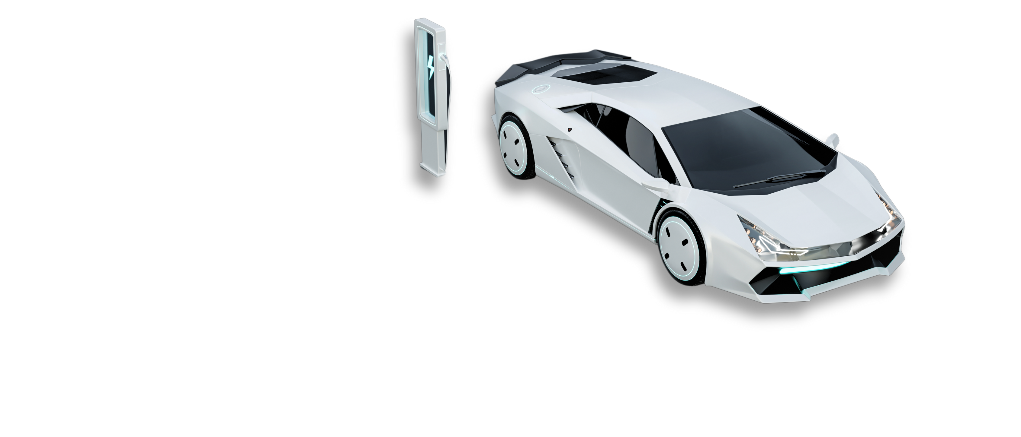
LB DRIVE - RENT A CAR
TechWrap LB
Software Development Department
Version: 28.3.26
Year: 2026

Slide 2

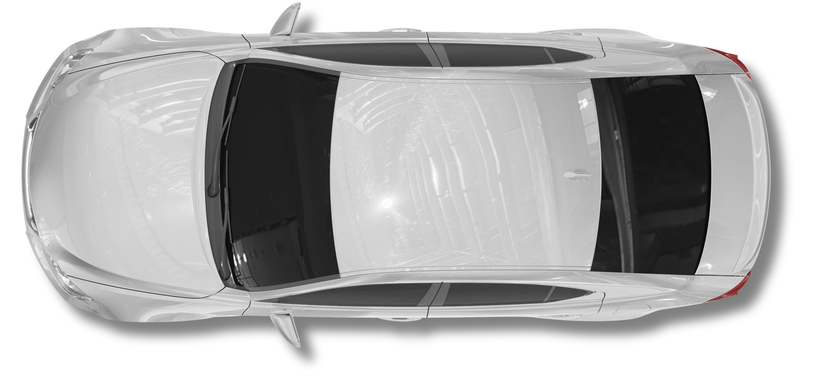
LB Drive
TABLE OF CONTENTS
Introduction
1
2
Problem It Solves
3
Similar Platforms
4
Added Values
5
Architecture Used
6
Technologies Used
7
Live Demo

Slide 3
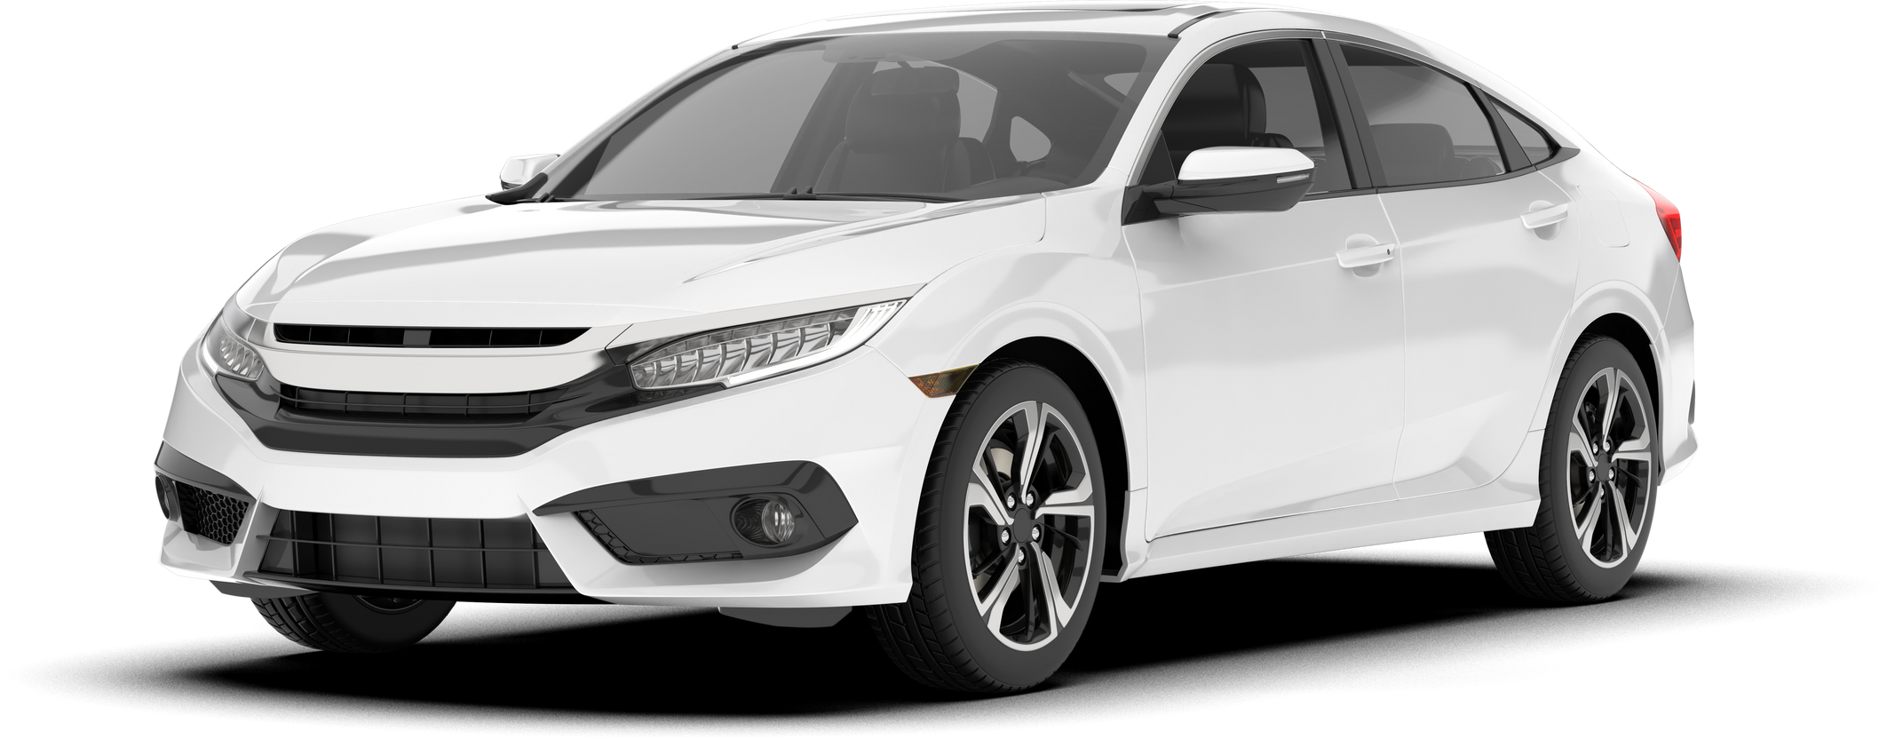
LB Drive
INTRODUCTION
Identified gap in Lebanese car rental market
Most companies rely on manual systems
Built LB Drive to digitize all operations end-to-end
Powered with AI chatbot for customer service

Slide 4
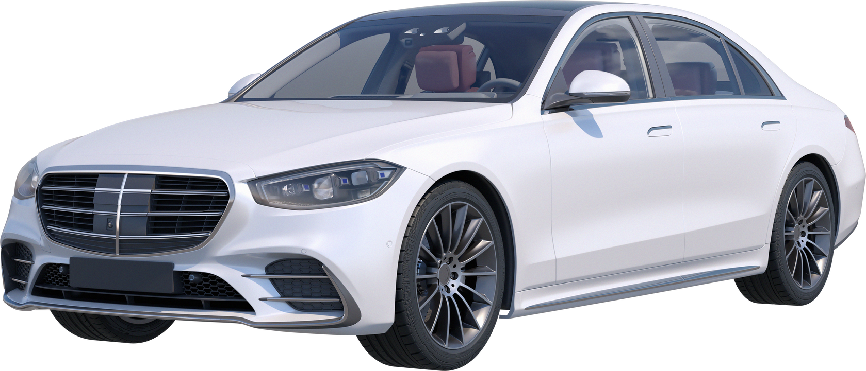

LB Drive
PROBLEMS IT SOLVES
Manual booking process
Limited automation
Scattered management
No real-time tracking
Weak financial monitoring
Poor customer communication

Slide 5



LB Drive
SIMILAR PLATFORMS
No online payment gateway
Poor User Experience
No real-time driver tracking
No verifying for driving license
No tracking for in-person booking
No real-time driver tracking
No customer support from website
Limited AI support
Customer support is WhatsApp link
No online payment
Customer can't sign up

Slide 6
LB Drive
ADDED VALUES
Live customer support (chat)
AI-powered assistance with real-time data
Secure online payments
Automated email & notifications
Real-time driver tracking
Account-based booking management
Online license verification

Slide 7
LB Drive
ROLES
Admin (manager)
Employee
Customer
Driver
Full system control
Manages operations & finances
Monitors logs & system settings
Validates customers
Creates & manages bookings
Handles live support tickets
Manages account & profile
Creates & tracks booking
Assigned to customer bookings
Executes trips

Slide 8
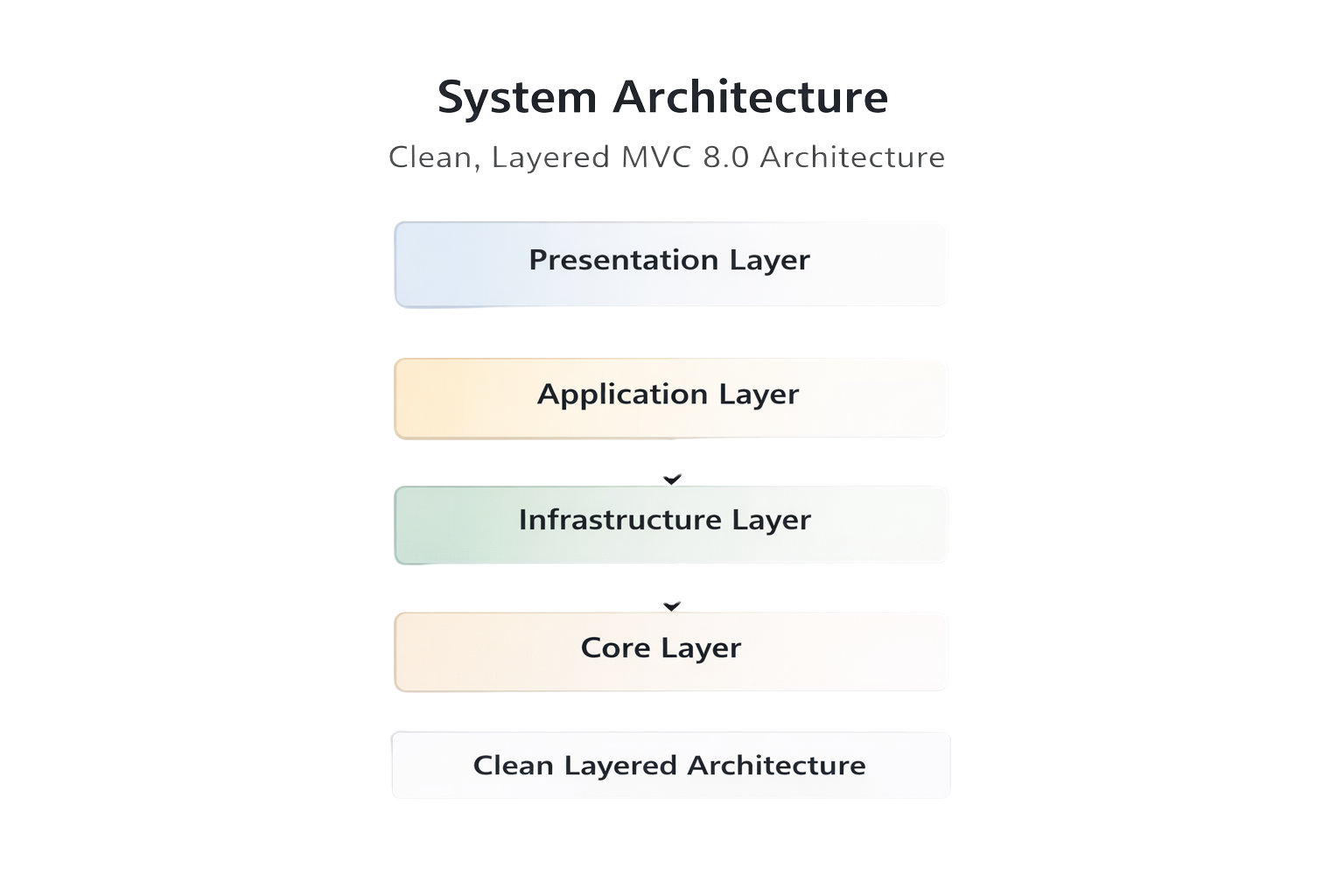
LB Drive
ARCHITECTURE
TECHNOLOGIES
Identity framework for authentication and authorization
Entity framework for database
ASP.NET CORE MVC 8.0 LTS

Slide 9






LB Drive
EXTERNAL SERVICES
Gemini API for the chatbot
Mailjet for the email service
Google maps API
Stripe payment gateway API
Cloud cluster for hosting
Cloud flare for the domain

Slide 10


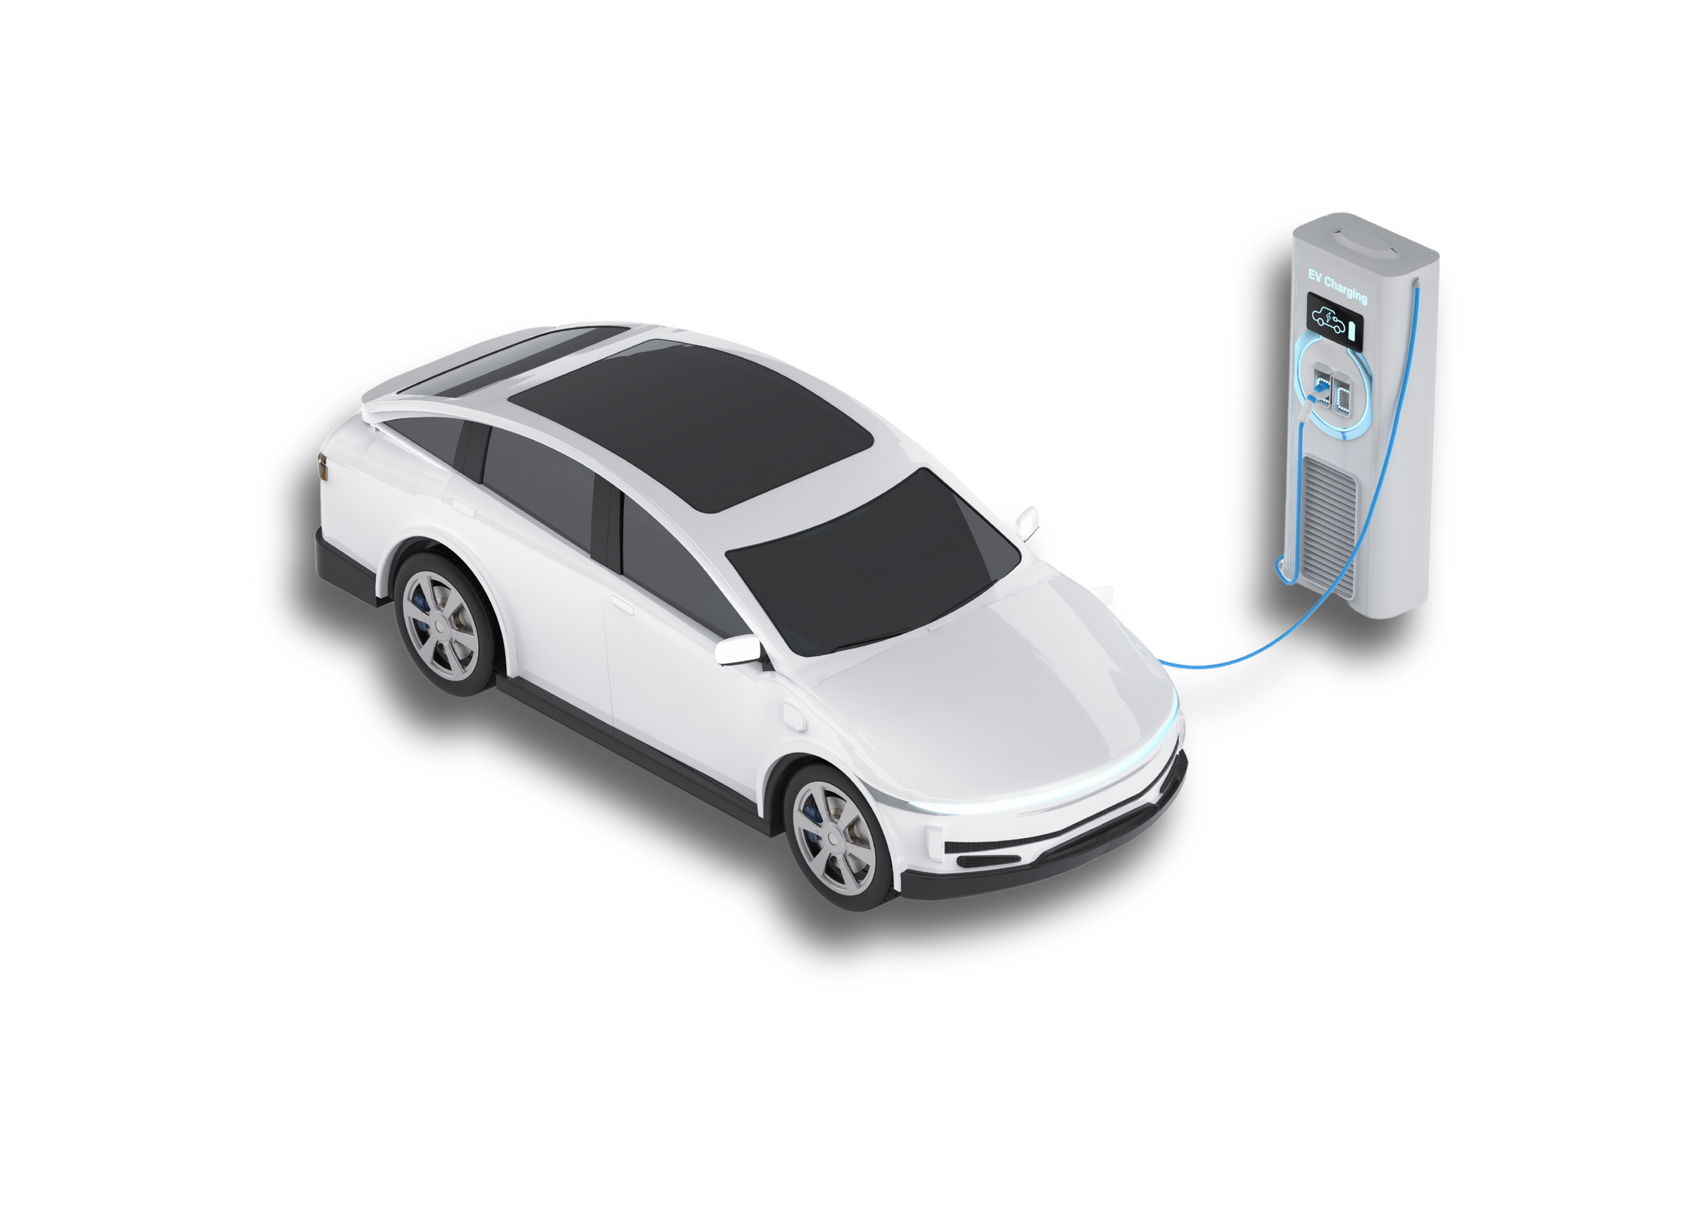
LB Drive
Now let’s move to the Live Demo

Slide 11


THANK YOU FOR LISTENING!
Any Questions?

